Slide 1
Multihop Inference for Explanation Regeneration
STAT 581 Final Project
Supervised by -
Prof. Michael Luvalle
Tianzhi Cao (tc324) Abhishek Bhatt (ab2083) Harshini Bonam (sdb202)

Slide 2
Motivation
An AI tutoring system providing correct answers but unable to explain why they are correct, limits the student’s ability to acquire a coherent grasp of the subject matter
A medical recommendation system that suggests a patient receive a particular surgery, but unable to explain why, presents challenges towards trusting that system

Slide 3
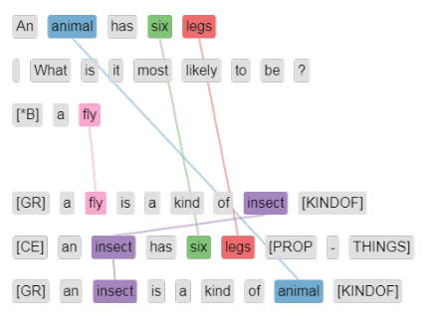
Problem Statement
Regenerating detailed gold explanations for standardized elementary science exam questions by selecting facts from a knowledge base of semi-structured tables

Slide 4
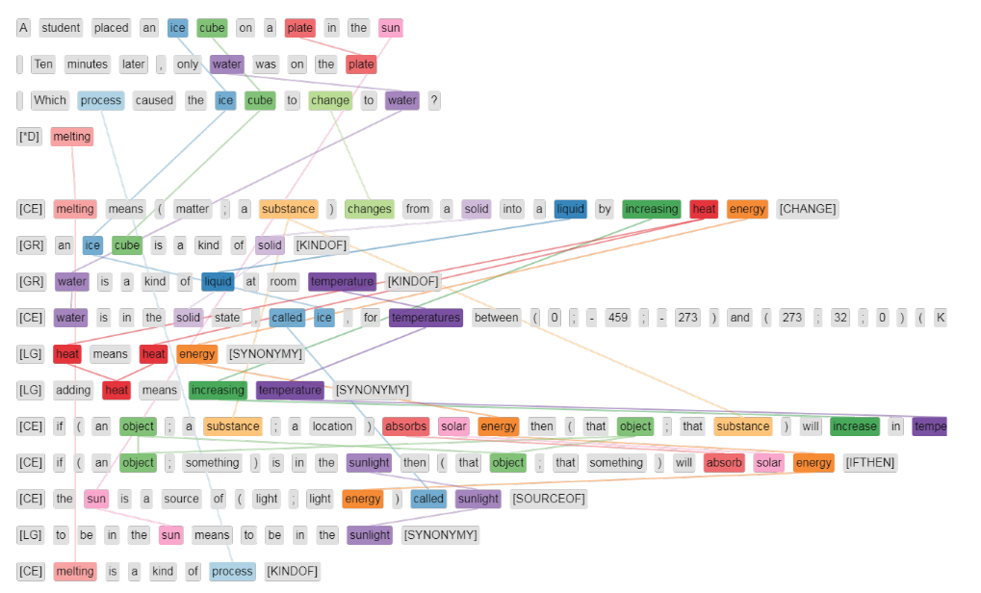
Approach
multi-hop inference : combining more than one piece of information (say combining free-text sentences from the web, or combining linked facts from a structured knowledge base) to solve an inference task, such as question answering

Slide 5
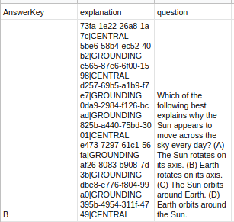
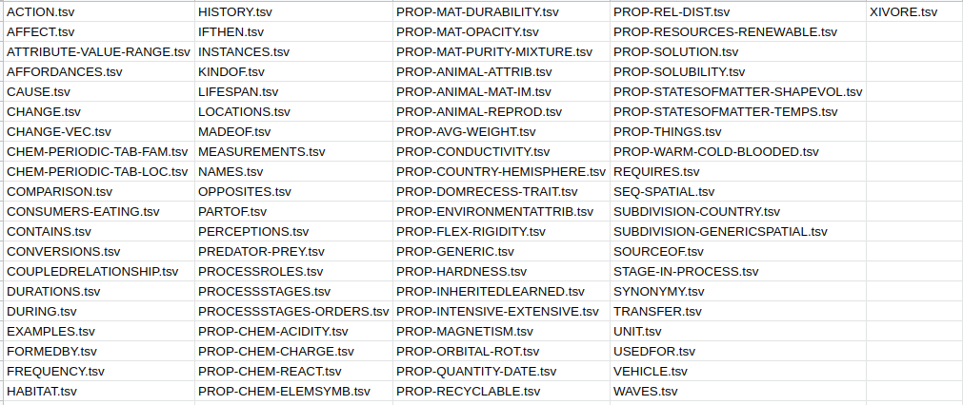
Dataset
QUESTIONS
WorldTree explanation corpus : standardized elementary science exam questions (3rd to 5th grade) drawn from the Aristo Reasoning Challenge (ARC) corpus
FACTS

Slide 6
Implemented Solution
Data Preparation
For facts, output an id column and a column for the complete fact string
E.g.
"a vehicle for something allows; enables that something to occur" "bb32-0bc0-3629-6bca"
For questions, output a column with question+answer string and a column for explanation
E.g.
“Which of the following best explains why the Sun appears to move across the sky every day? Earth rotates on its axis.”
“a7ec-4506-0e8a-ce2e|CENTRAL fe39-10c4-9dd9-d745|LEXGLUE e931-7db5-7b7d-6c1a|LEXGLUE 95aa-008a-1446-db3b|LEXGLUE a989-b05f-cf6d-e8ee|LEXGLUE”

Slide 7
Similarity Calculation
Steps
Preprocessing the data
Tokenization
Create Dictionary/Vectorizer
Create Document Term Matrix
Calculate Cosine Similarity

Slide 8
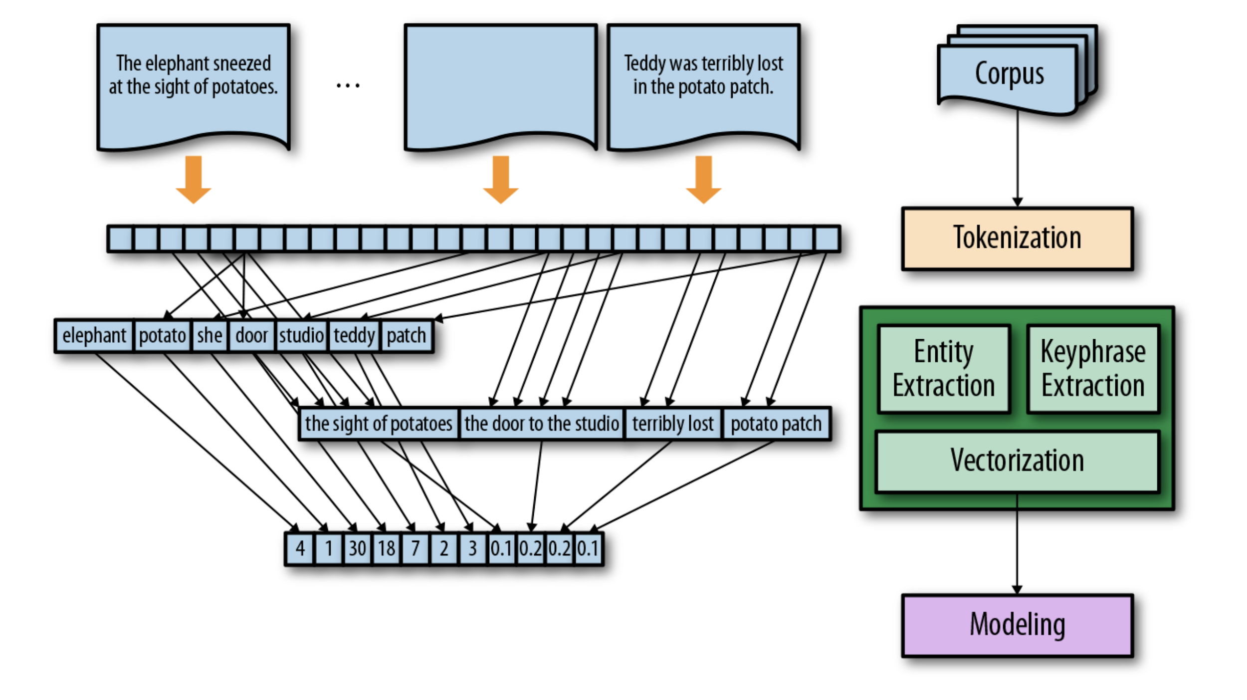

Slide 9
Preprocessing Data
Lower all letter
Remove non-alphanumeric character
collapse multiple space
Example:
an animal's brain controls that animal
an animal s brain controls that animal

Slide 10
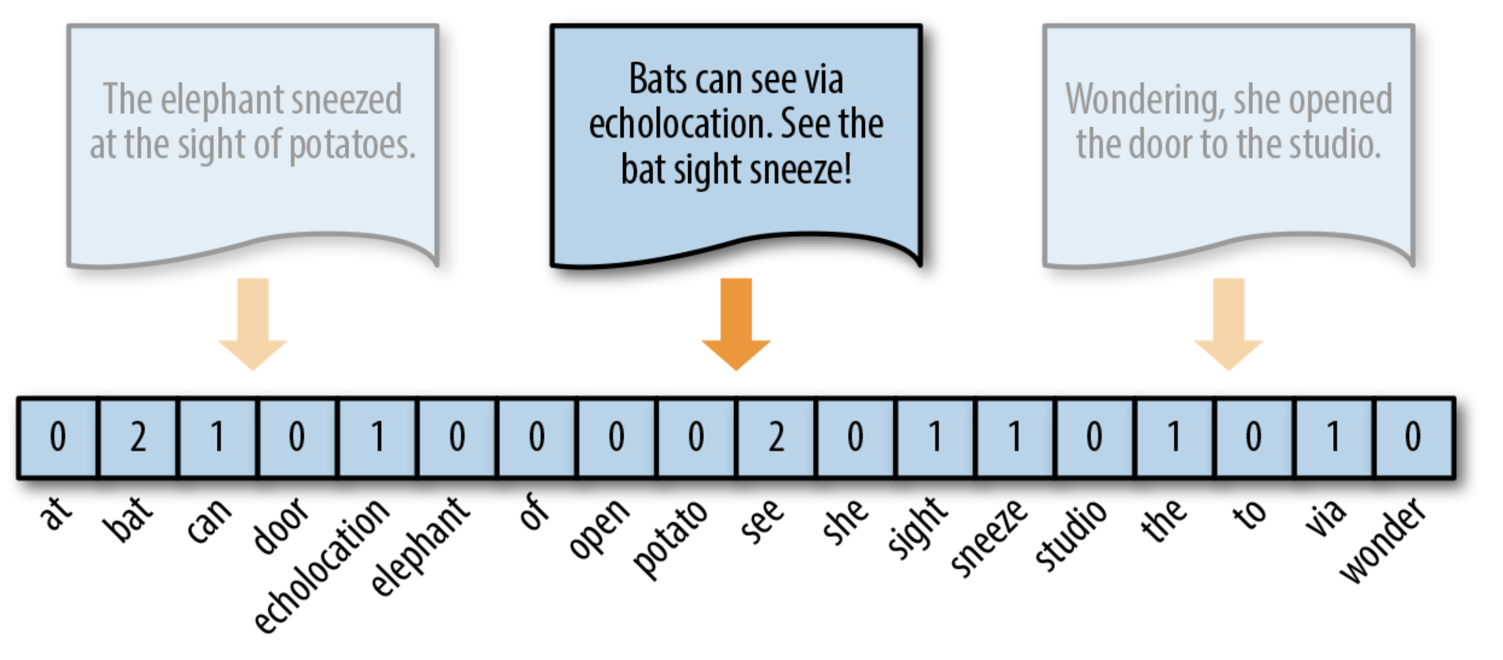
Tokenize Document
Tokenization Documents As Word
Compare Tokens in Each Doc to Get Similarity

Slide 11
Create Dictionary/Vectorizer
Create Based On Question Documents
Goal: Makes document more “clean”
Remove “Stop Word”
Stop Word: Words Do Not Have Any Meaning (i.e. "of’, "this").
Remove High Frequency Words
Vectorizer Creates Based on Dictionary

Slide 12
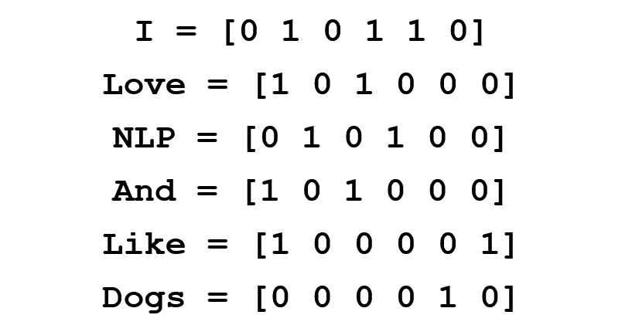
What is Vectorizer?
Word Vector

Slide 13
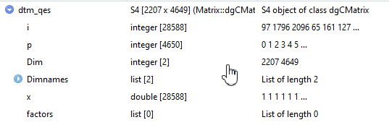
Create DTM
DTM--Document-Term Matrix
Describes the Frequency of Terms Occur
Matrix Height: Document Number
Matrix Length: Vectorizer Length

Slide 14
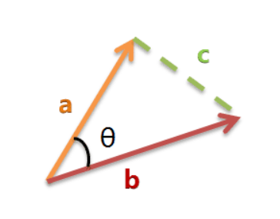
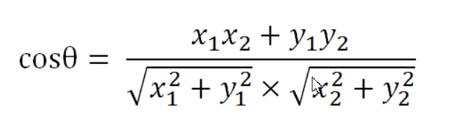
Calculate Cosine Similarity
Let’s Say We Just Have Two Words in Vectorizer
Doc1=[x1,y1] Doc2=[x2,y2]
Expand to N Dimension, Still Correct

Slide 15
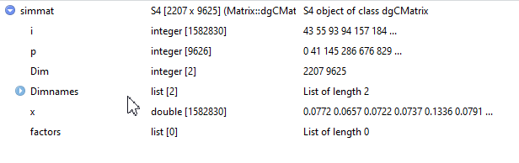
Final Matrix
Then Get Top 5 For Each Questions.

Slide 16
Observations and Analysis
No relevant fact extracted (e.g. the ground truth explanation includes facts 1,2,3,6,9 and our approach finds and explanation with facts 4,5,7,8,10)
30.26% of all the questions in the dataset
Find at least one relevant fact for its correct answer explanation
Around 70% of all the questions in the dataset
On an average, for a given question, our solution can find 0.9954 relevant facts.

Slide 17
Challenging cases with cosine similarity measure
Some irrelevant word in the ques+correct ans string might repeat multiple times
Some questions need "explanations" of explanation
Cosine similarity is more likely to find short facts (where there is just one prominent word or phrase), even if irrelevant

Slide 18
References
2019 shared task: Reasoning over chains of facts for explainable multi-hop inference: https://www.aclweb.org/anthology/D19-5313/
Machine reading comprehension : https://futuretodayinstitute.com/trend/artificial-intelligence/machine-reading-comprehension-mrc/
Language Models : https://en.wikipedia.org/wiki/Language_model
Worldtree corpus (v2.1) of explanation graphs and inference patterns : http://cognitiveai.org/explanationbank/
https://www.oreilly.com/library/view/applied-text-analysis/9781491963036/ch04.html

Slide 19
Thank You
Questions?

